Slide 1
End of Life Insights Pack September 2023
Dr Heidi Bowring, Clinical Fellow
Dr Sam Williamson, Associate Medical Director

Slide 2
Contents
Identification
EOL Register Profile
Proactive and Advanced Care Planning
Urgent and Emergency Care
Achieving a Better Death

Slide 3
Summary
The End of Life and Palliative Care Information Pack provides an overview of our population who are nearing the end of their lives or requiring palliative care support.
The pack covers different aspects of end of life care, including identification and proactive management of people nearing the end of their lives; the demographic and wider determinants profile of people on the end of life register; urgent and emergency care; and achieving a better death.
Clicking on the images opposite will link to the relevant sections of the information pack.

Slide 4
Key messages
Adopting core care processes to improve detection and management of EOL.
There is further opportunity to adopt and embed processes that support identification and management of people who are nearing the end of their lives.
Use of the Gold Standards Framework (GSF) Prognostic Identification Guidance (PIG) will improve the identification of people who are nearing the end of their lives and stimulate early discussion and planning between health care professions and patients and their families.
The use of GSF also supports the staging of disease, planning care and supporting patients by meeting their needs.
Improving data quality and data recording.
Whilst significant variation is seen across a number of metrics, this is likely to be due to differences in recording of information using systematic, standardised codes.
Better identification and understanding of people at the end of their life will be possible with improved data quality, including better coding of people who are nearing the end of their life (GSF staging), better coding of care delivered (key care processes) and better recording of demographic (e.g. ethnicity) and wider determinants (e.g. carer status).
Reducing unplanned care.
People in the last year of life still experience a high number of emergency and urgent care episodes, with a high cost. Whilst much of this care may be in line with patient wishes, many people are not supported to die or be cared for in in their preferred place.
Sharing of information between providers and recording information in the primary care record will ensure that people who are assessed for being in the last year of life will ensure that all providers are aware of an individual’s end of life status and any advance planning decisions that are in place. This will support people to achieve their preferred place of care and preferred place of death at the end of their lives.

Slide 5
Opportunities and Actions
Across the ICS, particularly in South West Herts, there are opportunities to further improve detection of people in the last year of life and recording this into the clinical record.
South West Herts should focus on this as the evidence nationally and locally point to a lower proportion of people on the end of life register and a higher rate of people dying in hospital.
In addition to better identification, all parts of the ICS should continue to actively use the GSF Prognostic Indicator Guide to assess people with long term conditions as part of their annual review.
All people who are identified as being in the last year of life should have an up to date GSF status to ensure that support and care is provided in line with the prognosis.
As part of the ECF, practices should continue to be incentivised to record an up to date GSF status on all people on the end of life register.
In addition to an up to date GSF status, people should have an effective anticipatory care plan (ACP), including PPC/PPD and DNACPR as well as a treatment escalation plan (TEP).
All people on the end of life register should have a ‘care bundle’ in line with best practice.
All people who are end of life should have their records shared and recieve treatment and care that is in accordance with their wishes (ACP and TEP). This will improve quality of life and patient and family experience and reduce the proportion of people with multiple emergency admissions in the last 3 months of life.
All staff directly involved (or likely to be involved) in the care of people who are end of life should have training in the importance of good care and support. This will ensure that people involved in decision making and that care is in line with ACP and TEPs.
The ICB and provider organisations should identify staff groups for training and provide training and development to increase skills in identification and management of people at the end of their lives.
Data from post-death audits would improve the ICS understanding of whether people with key care processes and care plans were more likely to die in their own home or PPC.
It is recommended that the ICB develop a clinical audit to review data on people that have died to establish differences in outcomes.

Slide 6
1. Identification

Slide 7
Identification: Summary
HWE has a lower percentage of patients recorded as being in need of palliative care/support (0.43%) when compared to the England mean (0.46%). This suggests there is further work needed to identify and record people as being end of life, including using the surprise question and assessing for signs of clinical deterioration as part of routine care.
The number of patients needing palliative care/support across both HWE and the rest of the country is rising though there has been a reduction in the most recent year in HWE.
All places are below the proportion of the population who are expected to die within a one year period (1%) suggesting under-detection of people who are in the last year of life.
ENH has the highest volume of patients on the EOL register (3150), followed by SWH (2283), then WE (1727). In SWH a recommendation is that information on people cared for in community services is shared with practices and entered into the clinical record to ensure coordinated care and that all care providers are aware of the end of life status, regardless of where that care is administered.
In HWE, there is good recording of GSF status for people with end-stage chronic diseases but many of these are likely to be recorded as GSF Blue.
Since October 2022, general practice has received additional funding to proactively review and identify people with advanced/end stage long term conditions who are not on the end of life register or do not have a GSF status. It is anticipated that this will support the identification of people who will benefit from palliative care and advance care planning.
Target groups for proactive identification of people is focused on end stage heart failure, COPD, CKD and severe frailty.

Slide 8
Identification: Patients in need of palliative care/support
Prevalence figures from QOF registers (21/22 data) show that HWE has a lower percentage of patients on the palliative care/End of Life register (0.43%) when compared to the England mean (0.46%). This equates to 6,900 people.
SWH has the lowest percentage of patients on the register (0.33%) whereas WE and ENH are higher than the national average (0.49% and 0.50% respectively 0.46%). Lower prevalence in SWH may be due to local services that are delivered by community providers.
Across the ICS and in all three Places, prevalence is below the 1% of the population estimated to be end of life. This means there is room for improving identification of people who may be nearing end of life and have palliative care needs.
Source: QOF Data, 2021/22
Up to date data from Ardens Manager, shows that the current EOL register in HWE is now 9146, representing a relative increase of 33% compared to 21/22 (note this is unvalidated data). The increase has primarily been seen in ENH (from 3093 to 4790) and WE (from 1576 to 2215). SWH continues to have a low number of people on the EOL register (2638) and presents a significant opportunity for improvement.

Slide 9
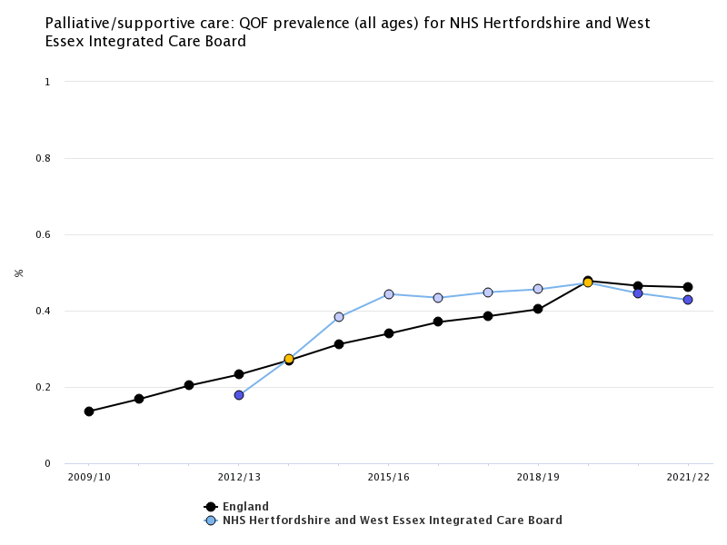
Identification: Patients in need of palliative care/support
Nationally, the proportion of patients needing palliative care/support has been rising, as expected with an ageing population.
However, for the two most recent years HWE prevalence has declined and is now statistically significantly lower than the national average.
This suggests that there is further opportunity to identify people who are in their last year of life or requiring palliative care support.
Source: Fingertips 2009-22

Slide 10
Identification: EOL Register by PCN
South West Herts
East & North Herts
West Essex
PCN | No. of patients on the EoL register | % of registered list
ABBEY HEALTH | 64 | 0.24%
ALBAN HEALTHCARE | 157 | 0.34%
ALLIANCE | 44 | 0.16%
ALPHA | 242 | 0.43%
ATTENBOROUGH | 99 | 0.32%
CENTRAL WATFORD | 103 | 0.29%
DACORUM BETA | 229 | 0.55%
DANAIS | 134 | 0.43%
DELTA | 103 | 0.29%
HALO | 113 | 0.33%
HARPENDEN HEALTH | 114 | 0.26%
HERTS FIVE | 293 | 0.43%
MVPS | 96 | 0.25%
NORTH WATFORD | 46 | 0.17%
POTTERS BAR | 117 | 0.39%
RICKMANSWORTH & CHORLEYWOOD | 65 | 0.22%
THE GRAND UNION | 163 | 0.28%
Total | 2231 | 0.33%
PCN | No. of patients on the EoL register | % of registered list
BROXBOURNE ALLIANCE | 201 | 0.44%
HATFIELD | 200 | 0.39%
HERTFORD AND RURALS | 241 | 0.47%
HITCHIN AND WHITWELL | 686 | 1.08%
HODDESDON & BROXBOURNE | 147 | 0.35%
ICKNIELD | 424 | 0.74%
LEA VALLEY HEALTH | 110 | 0.34%
STEVENAGE NORTH | 212 | 0.38%
STEVENAGE SOUTH | 260 | 0.45%
STORT VALLEY & VILLAGES | 215 | 0.33%
WARE AND RURALS | 162 | 0.46%
WELWYN GARDEN CITY A | 235 | 0.41%
Total | 3093 | 0.50%
PCN | No. of patients on the EoL register | % of registered list
EPPING FOREST NORTH | 368 | 0.56%
HARLOW NORTH | 178 | 0.29%
HARLOW SOUTH | 175 | 0.42%
LOUGHTON, BUCKHURST HILL & CHIGWELL | 352 | 0.58%
NORTH UTTLESFORD | 258 | 0.62%
SOUTH UTTLESFORD | 245 | 0.45%
Total | 1576 | 0.49%
QOF data from 21/22 show the proportion of the population within each PCN that is on the end of life/palliative care register.
More recent local data shows that, whilst the total number of people on the register has increase, the areas with the lowest proportion are similar to this.
Source: QOF 2021/22

Slide 11
Identification: GSF Complete
Source: Ardens Manager ECF 2022/23
This is one of the most complete care processes in the Enhanced Commissioning Framework within the ICB with 94% of people who have severe COPD, heart failure, chronic kidney disease or frailty have a GSF status recorded.
However, as a high proportion of people with a GSF status are classified as GSF Blue, it is likely that people with advanced disease are being recorded as GSF Blue and therefore not being entered onto the end of life register.
Ensuring that people with advanced disease are being appropriately classified could be confirmed through clinical audit of people on the end of life register and post-death audit to review if people were on the end of life register and if their record of GSF status is accurate.

Slide 12
2. EOL Register Profile

Slide 13
EOL Register Profile: Summary
As expected, the EOL register has a very strong relationship with age. The proportion of people in each age band who are on the end of life register rises steeply after 65-69 years of age.
The majority of the EOL population in HWE are white (88%.) This is higher than for the general population (70%.).Whilst there may be room for improvement in the recognition of EOL in ethnic minorities the variation may be due to the higher prevalence of end of life and white ethnicity in older age groups within HWE. SWH has the highest proportion of EOL patients who are BAME (12.6%) which is double that of ENH (6.3%) and more than three times that of WE (4.1%).
The proportion of the population that is recorded as being end of life is similar in each deprivation decile, suggesting that there is no inequality in identifying end of life in more deprived communities.
The most common physical comorbidities within the EOL cohort are hypertension (62%,) cancer (51%) and chronic cardiac disease (44%). Nearly half (44%) of people on the end of life register have a mental health condition (including depression and anxiety).
Approximately a quarter (22.3%) of people on the end of life register are in receipt of care and around 1 in 8 of the EOL cohort are in fact a carer themselves (12.6%).

Slide 14
EOL Register Profile: Demographics
Applying the HWE segmentation, 3% of the HWE population are in the ‘EoL, frailty & dementia’ segment, representing people with end of life and palliative care, severe frailty and severe dementia.
Of this cohort, 29% are end of life, equating to 11,057 people. This is greater than the general practice register size as the segment uses a wider definition and information from wider sources to assign people to the End of life and palliative care segment.
Source: HWE linked data, Jan 22

Slide 15
EOL Register Profile: Demographics
Proportion of population in each life segment, by place
In all places, the EoL, frailty and dementia cohort are the smallest cohort
ENH has the highest proportion of EoL, frailty and dementia patients (4%,) roughly double that of each SWH and WE (2% each)
WE has the highest proportion of people in the healthy segment (55%).
Source: HWE linked data, Jan 22

Slide 16
Profile: EoL register by GSF status
Primary care data, via Ardens Manager. June 2023
 | Coverage | EOL Register | On GSF | GSF Blue |  | GSF Green |  | GSF Yellow |  | GSF Red |  | On GSF Green/Yellow/Red
SWH | 52/53 practices | 2,008 | 896 | 162 | 8.1% | 360 | 17.9% | 66 | 3.3% | 6 | 0.3% | 432 | 21.5%
ENH | 44/48 practices | 4,566 | 3,656 | 2,640 | 57.8% | 838 | 18.4% | 131 | 2.9% | 37 | 0.8% | 1,006 | 22.0%
WE | 22/30 practices | 1,697 | 1,335 | 727 | 42.8% | 453 | 26.7% | 131 | 7.7% | 26 | 1.5% | 610 | 35.9%
Total | 118/131 practices | 8,271 | 5,887 | 3,529 | 42.7% | 1,651 | 20.0% | 328 | 4.0% | 69 | 0.8% | 2,048 | 24.8%
Data from June 2023 show that the number of people on the EOL register is currently over 8,200 and nearly 6,000 people have a GSF status.
Nearly a quarter of people on the EOL register have a GSF status (green, yellow or red).
There is significant variation with ENH practices having more people on the end of life register and GSF status. However, In ENH, more people with a GSF status are recorded as Blue compared to the other areas. WE has the highest proportion of people on the EOL register with a GSF status.
It is important to note that people recorded as GSF Blue are not entered onto the register. In addition, there are additional SNOMED codes that will assign people to GSF, meaning that figures for green/amber/red do not sum to total number ‘on GSF’.
There is also variation in the number of people who are ‘on GSF’ and the proportion who have a GSF status (blue, green, yellow or red). This is explained by the fact that some people may have separate codes for ‘on Gold Standard palliative care framework’, ‘GSF supportive care stage 1 or 2’. This is particularly evident in SWH where the majority of people ‘on GSF’ do not have a GSF status.

Slide 17
EOL Register Profile: Population Measures
Overall Population Measures | HWE Overall | ENH | SWH | WE
Population in EOL sub-segment | 11057 | 3971 | 6079 | 1007
Average of Age | 73.4 | 74.9 | 71.9 | 76.4
% BAME Where recorded | 9.5% | 6.3% | 12.6% | 4.1%
Avg Acute & Chronic Conditions | 5.0 | 4.7 | 5.2 | 5.0
Using the linked data and a wider definition to assign people to the end of life cohort, SWH has the most EOL patients (6079), followed by ENH (3971), and then WE (1007).
The EOL population in WE tends to be older (mean 76) than in SWH (mean 72).
SWH has the highest proportion of EOL patients who are BAME (12.6%) which is double that of ENH (6.3%) and more than 3x that of WE (4.1%).
Source: HWE linked data, Jan 22
Note: Linked HWE data from Jan 22 used a wider definition of end of life and palliative care (including metastatic cancer). As a consequence, more people are allocated to the EOL segment than are on the EOL register.

Slide 18
EoL Register Profile: Age
The proportion of people in each age group who are on the EoL register increases with age.
Approximately one in every six people (16%) aged over 90 years is on the EoL register.
Compared to UK life tables, after 45-49 years the proportion of people on the end of life register is below the estimated proportion of people at each age group who die within the next year.
This shows that there are opportunities to improve detection of people at the end of their life across all age groups.
Source: HWE linked data, Jan 22

Slide 19
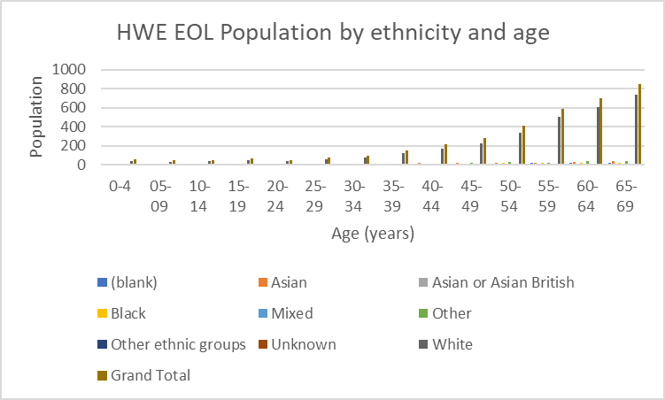
EOL Register Profile: Ethnicity
The majority of the EOL population in HWE are white (88%.) This is a higher proportion than for the general population (70%).
This is likely to reflect the older age of the end of life register, and that a higher proportion of the older age group are of white ethnicity. However, it might mean that those who are non-white are less likely to be recognised when they are nearing EOL.
Identification of EOL is important to ensure subsequent care processes are carried out to optimise the dying process
Therefore, there may be room for improvement in the recognition and subsequent management of EOL in ethnic minorities.
Source: HWE linked data, Jan 22

Slide 20
EOL Register Profile: Deprivation
Those in the EOL subsegment are less likely to be deprived, reflective of the overall population in HWE.
There is no clear gradient across deprivation deciles. Whilst a lower proportion of people in the most deprived decile are allocated to the EOL segment, the numbers are small and likely not to be statistically significantly different.
However, as risk factors, chronic conditions and multi-morbidity are more common in more deprived communities, there is likely to be an under-identification of end of life among more deprived groups.
IMD Decile | 1 | 2 | 3 | 4 | 5 | 6 | 7 | 8 | 9 | 10 | (blank) | Grand Total
5c - EoLFD (End of Life) | 0.6% | 1.2% | 0.8% | 0.9% | 0.8% | 0.8% | 0.9% | 0.9% | 1.0% | 0.9% | 0.7% | 0.9%
Source: HWE linked data, Jan 22

Slide 21
EOL Register Profile: Comorbidities
Physical Health | HWE | ENH | SWH | WE
Asthma | 20.1% | 17.2% | 21.7% | 22.1%
Cancer | 51.2% | 49.5% | 53.4% | 44.7%
Chronic Cardiac Disease | 44.0% | 42.3% | 44.8% | 46.1%
Chronic Respiratory Disease | 22.4% | 22.0% | 22.3% | 25.3%
CKD | 13.8% | 13.1% | 15.0% | 9.3%
Hypertension | 61.7% | 61.0% | 62.3% | 61.0%
Diabetes | 35.4% | 28.0% | 41.2% | 30.1%
Obesity | 24.7% | 22.8% | 27.3% | 15.9%
Rheumatoid Arthritis | 3.8% | 3.1% | 3.9% | 6.6%
Stroke | 31.2% | 28.1% | 33.8% | 28.3%
A high proportion of people on the EOL register have Cardiovascular, respiratory, renal or cancer diagnoses. The most common physical comorbidities within the EOL cohort are hypertension (62%,) cancer (51%) and chronic cardiac disease (44%)
Most of these conditions have prevalence's that are relatively similar in each place across HWE
Mental health conditions also have a high prevalence among people on the end of life register, with two in every five people (41%) having at least one mental health condition (MH Flag).
Dementia rates within the EOL population are lower than expected and may reflect under-recording and under-diagnosis.
Mental Health | HWE | ENH | SWH | WE
Anxiety | 22.9% | 25.5% | 21.7% | 19.8%
Depression | 27.7% | 25.8% | 29.7% | 22.8%
Dementia | 20.3% | 19.6% | 20.0% | 25.1%
Serious Mental Illness | 5.5% | 2.9% | 7.7% | 2.7%
Low Mood | 13.9% | 15.2% | 13.9% | 8.8%
MH Flag | 41.2% | 42.9% | 41.3% | 33.4%
Source: HWE linked data, Jan 22

Slide 22
EOL Register Profile: Co-morbidities
People who are nearing the end of their lives have a high level of multi-morbidity.
The majority of people living with 4 or more long term conditions.
Source: HWE linked data, Jan 22

Slide 23
EOL Register Profile: Social Indicators
Roughly a quarter of EOL patients in HWE have a carer, although there is variation at place level (29.4% in ENH vs. 7.6% in WE) with variation likely to be due to coding and data quality.
Around 1 in 8 of the EOL cohort are a carer themselves. ENH has a particularly high rate of people who are at the end of their lives and a carer (20.9%).
Nearly 1 in 7 patients classified as EOL are housebound and 1 in 5 are socially vulnerable.
Wider and Social determinants | HWE | ENH | SWH | WE
Has A Carer | 22.3% | 29.4% | 20.0% | 7.6%
Is A Carer | 12.6% | 20.9% | 8.9% | 2.4%
MED3 Not Fit For Work (ever) | 14.7% | 11.6% | 18.2% | 5.6%
MED3 Not Fit For Work In Last Year | 4.1% | 3.8% | 4.6% | 2.3%
MED3 Not Fit For Work in Last 6 Months | 3.2% | 3.1% | 3.5% | 1.3%
Average No. of eFI Deficits (max=36) | 9.7 | 10.8 | 9.1 | 8.5
EFI - Housebound | 13.3% | 17.7% | 11.1% | 9.1%
EFI - Social Vulnerability | 20.9% | 20.5% | 23.0% | 10.2%
Children In Poverty | 14.7 | 16.8 | 12.7 | 11.76
Housing Fuel Poverty | 11.0 | 11.5 | 10.5 | 12.17
One Person Household | 28.3 | 28.6 | 28.2 | 27.31
Source: HWE linked data, Jan 22

Slide 24
3. Proactive and Advanced Care Planning

Slide 25
Proactive and Advanced Care Planning: Summary
Advance care planning ensures that the needs of people on the end of life register are identified and plans are in place to meet those needs, including respecting wishes at the very end of life.
In all places, there is room for improvement in recording GSF prognostic indicator for those on the EOL register. However, rates of completion are lowest in SWH. Recording the GSF prognostic indicator supports with advance care planning by ensuring that appropriate discussions are had with the patient and family/carers and care and support is in place to meet specific needs.
Very few patients on the end of life register are recorded as having a care plan done (27%-15% across the three places).
In all places, >50% of those on the EOL register have resus status recorded.
HWE has been very successful in appointing palliative and end of life care leads in practices

Slide 26
Proactive and Advanced Care Planning: What is ‘good’ care?
People who are nearing the end of life or requiring palliative care support benefit from proactive management and advance care planning. Good quality care for this group of people is outlined in the Gold Standards Framework and Advance Care Planning (ACP). Good care for people at the end of life includes:
Minimum of an annual review, with increased frequency of review and ACP according to GSF status.
Advance care planning encompassing the following care processes, as a minimum.
Up to date GSF status
A current DNACPR status, Preferred place of care (PPC) status, Preferred place of death (PPD) status.
People who are in the last weeks or days of life (GSF amber or red) should be considered for anticipatory medications
People on the end of life register should be discussed as part of an MDT, with the frequency of discussion determined by needs and reflecting the GSF status.
Recording of information on an individual’s ACP and GSF status in the clinical record and sharing of this across providers.
These care processes are locally commissioned in primary care through the enhanced commissioning framework.

Slide 27
Proactive and Advanced Care Planning: GSF status recorded in the last 12 months*
All patients who are on the end of life register should have a GSF prognostic indicator recorded or updated within the last year as a minimum (and more regularly depending on GSF status).
Across the ICS, 45 % of people on the EoL register had a GSF status recorded in the 12 month period of the financial year 22/23.
There is significant variation in the completion of GSF status at place level. In WE and ENH, over half of the patients on the EOL register have a GSF prognostic indicator recorded (55% and 50% respectively.) This rate is lower in SWH, at 31.6%. The lower rate may be due to data from some practices not being pulled through to Ardens Manager.
Some PCNs in SWH have very low uptake, potentially reflecting either coding practice or issues with extracting data.
In all places, there is room for improvement in recording GSF prognostic indicator for those on the EOL register
*Broken down to practice level, see appendix
Source: General practice data, via Ardens Manager. 2022/23
Sub-ICB | ECF 2022-23: % of patients on the EoL register who have a GSF prognostic indicator recorded
WEST ESSEX | 54.5%
EAST & NORTH HERTS | 50.3%
SOUTH & WEST HERTS | 31.6%

Slide 28
Proactive and Advanced Care Planning: Care Plan Done
It is recommended that people on the end of life register are reviewed on at least an annual basis. The care plan should be reviewed and updated.
During the 22/23 financial year, recording of care plan completion (including care plan reviews or declined care plans) was 20%.
There is significant variation across HWE at both Place and PCN level.
At PCN level, whilst some areas achieved 57% completion, other areas only achieved completion in 4% of people on the EOL register.
Completion was highest in SWH (28%), with ENH (16%) and WE (15%) at lower levels). SWH performance is likely to be higher due to having significantly fewer people on the EOL register to review.
Ensuring that care plans are complete and recorded in the clinical record in primary care ensures that people supporting and caring for patients nearing the end of their lives are aware of patient wishes and understand treatment plans.
Source: General practice data, via Ardens Manager. 2022/23

Slide 29
Proactive and Advanced Care Planning: Resus Status Recorded
Across the ICS, 56.6% of people on the end of life register have a resuscitation status recorded as part of advance care planning.
Despite having the lowest rates of completing a care plan, WE has the highest rate of recording DNACPR/resus status (63%.) As recording resuscitation status is part of advanced care planning, this shows that there may be data quality issues for the ACP metric.
Source: General practice data, via Ardens Manager. 2022/23

Slide 30
Proactive and Advanced Care Planning: Recording Preferred Place of Care and Preferred Place of Death
Recording preferred place of care is part of advanced care planning.
ENH is performing well in this metric: nearly 2/3 of those on the register have a PPC recorded (66%).
In SWH, about a third of those on the EOL register have a PPC recorded (32%).
Results for this metric are very similar to that of Preferred Place of Care (on previous page),
This is likely to be due to the information being captured and recorded in the clinical record at the same time.
As with PPC, SWH has the lowest rates of recording. Ensuring this information is recorded in the primary care record is important in ensuring that care is joined up and
Source: General practice data, via Ardens Manager. 2022/23

Slide 31
Proactive and Advanced Care Planning: Anticipatory Medicines (for GSF Amber/Red)
SWH has the highest rates of prescribing anticipatory medicines for those who are GSF red/yellow (73%)
Rates are lower in ENH (66%) and even more so in WE (57%)
Source: General practice data, via Ardens Manager. 2022/23

Slide 32
Proactive and Advanced Care Planning: Palliative Care Leads
HWE has been very successful in appointing palliative and end of life care leads in practices:
Palliative care leads have been identified in 97% of GP practices in HWE
Source: Ardens Manager ECF 2022/23

Slide 33
4. Urgent and Emergency Care & EOL

Slide 34
UEC & EOL Slides: Summary
HWE is performing similarly to the rest of the country for the percentage of deaths with 3 or more emergency admissions in the last three months of life
Within the EoL segment:
With increasing age comes increasing volume of patients and associated cost of A&E attendances
A&E attendances for those in segment 5 (EoLFD) are very common, with frequent attendances due to weakness (14%,) dyspnoea (14%,) chest pain (12%, and unsteady gait (12%)
Emergency admissions are also highest in this segment, alongside people with severe dementia. Common reasons for admission are exacerbations of underlying long term conditions and infective causes as well as falls and fractures.
In the end of life subsegment, ACS admissions are most commonly due to CVD: congestive heart failure, Respiratory: COPD and CVD: AF and flutter

Slide 35
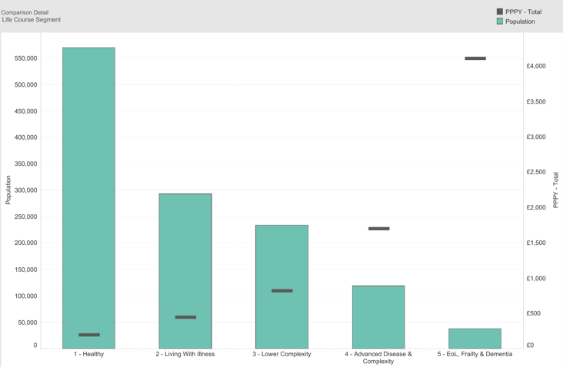
UEC & EOL: Cost PPPY
Population and healthcare cost PPPY- by life segment
Worsening health status is associated with increasing cost per person per year (PPPY), with the majority of those costs coming from urgent and emergency care.
In the chart opposite, the bar represents the number of people in each segment and the line represents the cost PPPY.
Whilst people in segment 5 (EoL, frailty and dementia) make up the smallest proportion of the population, they have the highest spend per person (>£4000pppy).
Those in segment 5 (EoL, frailty and dementia) have roughly 16x more spent on them PPPY compared to those in segment 1 (healthy). >£4000 PPPY compared to ~£250 PPPY for the ‘healthy’ population.
Source: HWE linked data, Jan 22

Slide 36
UEC & EOL: A&E attendances
Chief complaint
Asthenia (Finding)
Dyspnea (Finding)
Unsteady Gait (Finding)
Abdominal Pain (Finding)
Chest Pain (Finding)
Injury Of Lower Limb (Disorder)
Pain In Lower Limb (Finding)
Injury Of Head (Disorder)
Fever (Finding)
Difficulty Breathing (Finding)
Asymptomatic (Finding)
Injury Of Upper Extremity (Disorder)
Clouded Consciousness (Finding)
Vomiting (Disorder)
Backache (Finding)
Skin Problem (Finding)
Seizure (Finding)
Retention Of Urine (Disorder)
Dizziness (Finding)
Near Syncope (Disorder)
Palpitations (Finding)
Diarrhoea (Finding)
Blood In Urine (Finding)
Headache (Finding)
On average, the rate of emergency department attendance for the 18 month period April ’21 to Sept ’22 for people in the end of life segment (n=11057) was 982 per 1000. This compares to a rate of 278 per 1000 across the HWE population. It is similar to the rates for the segment 5 – EoLFD as a whole (932 per 1000).
The main reasons for emergency attendance for people in the end of life segment are shown in the table opposite.
Whilst there are a number of complaints that have limited description (asthenia, clouded consciousness, asymptomatic) these are likely to represent general issues of frailty, social difficulties and difficulty managing at home or usual place of residence.
In addition to these ‘non-descript’ complaints, many attendances are linked to infective causes, exacerbations of long term conditions or injuries and musculoskeletal issues.

Slide 37
UEC & EOL: Emergency admissions
Primary diagnosis
Urinary tract infection, site not specified
Lobar pneumonia, unspecified
Sepsis, unspecified
Tendency to fall, not elsewhere classified
Emergency use of U07.1
Chronic obstructive pulmonary disease with acute lower respiratory infection
Congestive heart failure
Pneumonia, unspecified
Acute renal failure, unspecified
Pneumonitis due to food and vomit
Unspecified acute lower respiratory infection
Fracture of neck of femur
Cellulitis of other parts of limb
Constipation
Disorders of calcium metabolism
Chronic obstructive pulmonary disease with acute exacerbation, unspecified
Anaemia, unspecified
Chest pain, unspecified
Atrial fibrillation and atrial flutter, unspecified
Syncope and collapse
Gastroenteritis and colitis of unspecified origin
The rate of emergency admission during the period April ’21 to September ’22 for people in the end of life segment was 760 per 1000. This compares to a rate of admission for the whole population over the same period of 75 per 10000.
The subsegments with the highest rates of emergency admission are 5b – Severe dementia (805 per 1000) and 5c – End of Life. Following this, there is a drop in the rate of emergency admission to 5a – Severe frailty (536 per 1000) and 4f – End stage disease (476 per 1000).
The most common reasons for admission are shown in the table opposite and show that the main reasons for admission are due to infective causes and exacerbations of underlying long term conditions as well as falls and fractures.
The rate of emergency admission for ambulatory care sensitive conditions in the End of Life segment is 95 per 1000. This compares to a rate of 9.2 per 1000 across the HWE population over the same time period.
Within the end of life subsegment, CVD, COPD and AF/flutter are the conditions causing the highest volume of ACS admissions and highest associated costs.
This cohort are likely to benefit from proactive management and admission avoidance for ambulatory care conditions.

Slide 38
UEC & EOL: Emergency admissions
Source: Fingertips, secondary care data. Accessed May 2023.
Approximately one in 14 people are admitted to hospital three or more times in the last three months of life in HWE. The local rate is statistically similar to the rest of the country.
Recent trends show a reduction since a peak of 8.3% in 2019.
The rates across each place are similar with ENH having the lowest (6.7%) and SWH and WE both having 7.4% of people admitted 3+ times in the last 3 months of life.
WE has seen a sharp drop in the proportion of people admitted three or more times since 2019, down tfrom 8.9% in 2019 to 7.4% in 2021.

Slide 39
5. Achieving a Better Death

Slide 40
Achieving a Better Death: Summary
The percentage of deaths occurring in hospital, care homes and hospices is higher in HWE compared to the rest of England. Whereas HWE has fewer deaths occurring at home or in ‘other places’ when compared to the rest of England.
This varies according to age and district. In particular, HWE patients aged 85+ had a higher percentage of deaths occurring in care homes and fewer deaths at home and in hospital compared to the rest of England.
The percentage of deaths occurring in hospital has been gradually decreasing since 2019. The percentage of deaths occurring at home has been gradually increasing since 2019.
Most HWE districts have rates of temporary care home resident deaths that are similar to the rest of England. The proportion of people in Broxbourne who died whilst living in temporary residential care is significantly higher than all other districts and the national average.
Deaths due to each cause in each age group in HWE are fairly aligned with the rest of England.
HWE has a higher percentage of all deaths who are 85+ compared to the rest of England.
People with dementia in HWE have higher rates of dying in hospital and lower rates of dying in usual place of residence or care homes when compared to the rest of England.

Slide 41
Achieving a Better Death: Percentage of deaths by age
HWE has a higher percentage of all deaths who are 85+ compared to the rest of England.
This is potentially due to HWE having a higher proportion of very elderly patients.
Percentage of all deaths who are <65, 65-74 and 75-84 is lower in HWE compared to the rest of the country.
Source: Fingertips, secondary care data. Accessed May 2023

Slide 42
Achieving a Better Death: Place of death
Source: Fingertips, secondary care data. Accessed May 2023
The percentage of deaths occurring in hospital, care homes and hospices is higher in HWE compared to the rest of England, although this is not statistically significant.
Whereas HWE has a statistically significantly lower proportion of deaths occurring at home or in ‘other places’ when compared to the rest of England.
In particular, HWE is an outlier in the percentage of deaths occurring at home, falling within the lowest-25th percentile range
Supporting people to be cared for and to die in their usual place of residence, including their own home will achieve better quality of deaths within the local population.

Slide 43
Achieving a Better Death: Place of death by cause of death
In HWE, just under half (46%) of patients whose cause of death is cancer, die in their usual place of residence (home, care home or religious establishment)
This is similar to the national median (45%)
ENH has the highest rate of cancer deaths in usual place of residence (52%)
Whereas SWH has the lowest rate of cancer deaths in usual place of residence (41%)
In comparison to cancer, less than a third (29%) of people in HWE whose cause of death is respiratory disease die in their usual place of residence (home, care home or religious establishment).
This is lower than the national median (32%) and puts HWE in the lowest quartile nationally.
All places within HWE have similar rates of respiratory disease deaths in usual place of residence.
Source: Model Hospital, 2017. Accessed May 2023.

Slide 44
Achieving a Better Death: Place of death
Percentage of deaths that occur in each location in HWE, compared to England
Place of death | <65 | 65-74 | 75-84 | 85+
Home | 34.1 | 31.2 | 26.3 | 21.8
Hospital | 45.8 | 50.1 | 49.5 | 40.8
Hospice | 9.3 | 8.1 | 5.1 | 2.6
Care Home | 3.6 | 7.4 | 17.3 | 34.0
Source: Fingertips 2021, secondary care data
Those aged 85+ have lower rates of dying at home, in a hospital or hospice compared to the rest of England, but have higher rates of dying in a care home
Those aged 75-84 are more likely to die in hospital and less likely to die in a care home compared to the rest of England
Those aged 65-74 have higher rates of dying at home, hospital or hospice compared to the rest of England.
Those aged under 65 have higher rates of dying at home or in a hospice compared to the rest of England

Slide 45
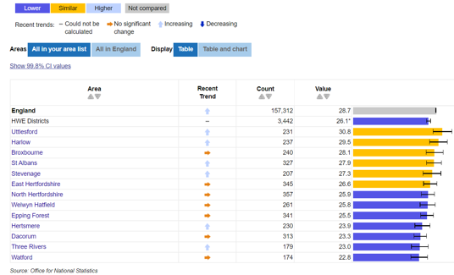
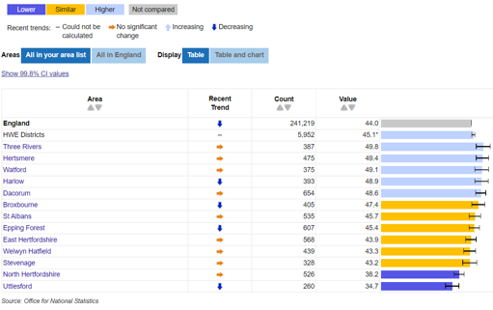
Achieving a Better Death: Place of death by HWE district
There is variation in place of death at district level
North Herts, Welwyn Hatfield, Epping Forest, Hertsmere, Dacorum, Three Rivers and Watford all have a lower percentage of deaths occurring at home compared to the rest of England
Three Rivers, Hertsmere, Watford, Harlow and Dacorum all have a higher percentage of deaths that occur in hospital compared to the rest of England
Source: Fingertips, secondary care data. Accessed May 2023.

Slide 46
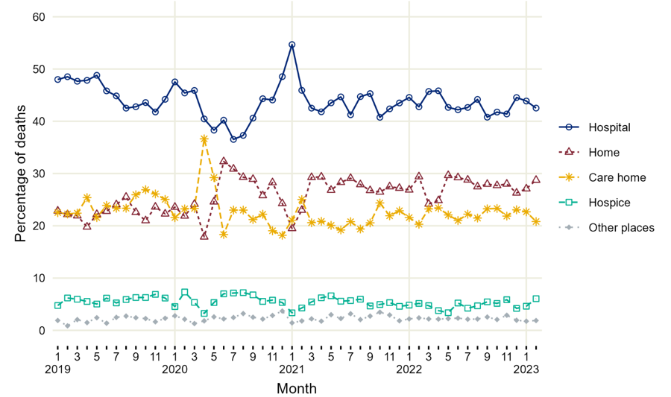
Monthly trend (%) in HWE deaths (all ages) by place of death, 2019 to 2023
Achieving a Better Death: Place of death trends over time
The percentage of deaths occurring in hospital has been gradually decreasing since 2019.
The percentage of deaths occurring at home has been gradually increasing since 2019 and higher than the pre-pandemic baseline period.
Rates of deaths in care homes, hospices and ‘other places’ has remained relatively stable.
Source: Fingertips, secondary care data. Accessed May 2023

Slide 47
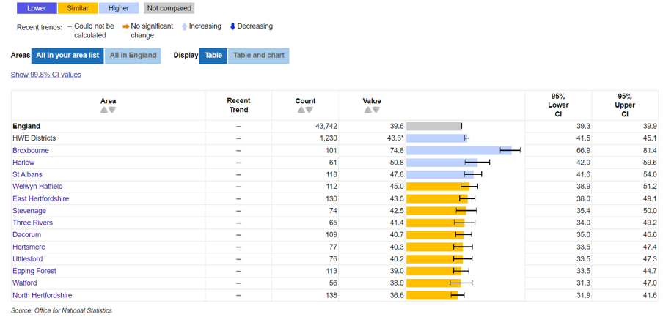
Achieving a Better Death: Deaths among temporary care home residents
There is variation in the number of deaths in temporary care home residents at district level.
Most HWE districts have rates of temporary care home resident deaths that are similar to the rest of England.
The exception to this is Broxbourne, Harlow and St Albans, which have higher rates of temporary care home resident deaths.
Source: Fingertips, secondary care data. Accessed May 2023.

Slide 48
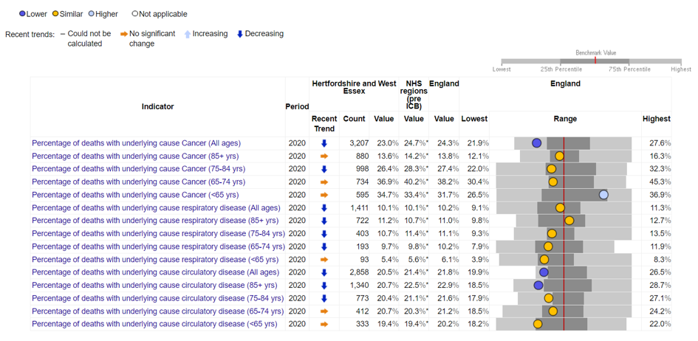
Achieving a Better Death: Cause of death
Deaths due to each cause in each age group in HWE are statistically similar to the rest of England. With a few exceptions:
Deaths due to cancer in those <65 are higher than the rest of England.
HWE has fewer deaths due to cancer across all ages compared to the rest of England.
HWE has fever deaths due to circulatory disease across all ages compared to the rest of England.
Source: Fingertips, secondary care data. Accessed May 2023

Slide 49
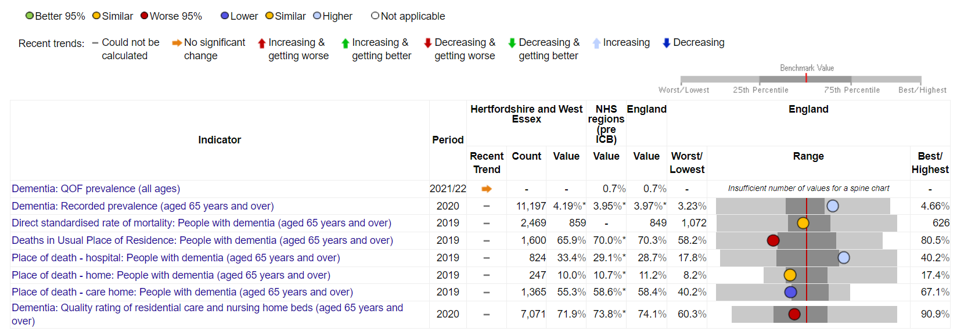
Achieving a Better Death: Dementia
Source: Fingertips 2019, secondary care data
People with dementia in HWE have higher rates of dying in hospital and lower rates of dying in usual place of residence or care homes when compared to the rest of England.

Slide 50
6.Appendix

Slide 51
GSF Prognostic Indicator Recorded- SWH by practice
SOUTH & WEST HERTS | ABBEY HEALTH | E82031 | MALTINGS SURGERY | 11 | 32 | 34.4%
 |  | E82107 | SUMMERFIELD HEALTH CENTRE | 1 | 22 | 4.5%
 | ALBAN HEALTHCARE | E82059 | GRANGE STREET SURGERY | 4 | 26 | 15.4%
 |  | E82055 | MIDWAY SURGERY | 5 | 81 | 6.2%
 |  | E82060 | PARKBURY HOUSE SURGERY | 16 | 51 | 31.4%
 | ALLIANCE | E82113 | COLNEY,COLERIDGE HSE & BRICKET WOOD MCS | 0 | 9 | 0.0%
 |  | E82020 | CONSULTING ROOMS | 0 | 17 | 0.0%
 |  | E82050 | GROVE HILL MEDICAL CENTRE | 0 | 7 | 0.0%
 |  | E82004 | HATFIELD ROAD SURGERY | 1 | 5 | 20.0%
 |  | E82070 | WOODHALL FARM MEDICAL CTR | 0 | 10 | 0.0%
 | ALPHA | E82652 | GOSSOMS END SURGERY | 5 | 6 | 83.3%
 |  | E82001 | ROTHSCHILD HOUSE GROUP | 88 | 190 | 46.3%
 |  | E82094 | THE MANOR STREET SURGERY | 14 | 37 | 37.8%
 | ATTENBOROUGH | E82124 | ATTENBOROUGH SURGERY | 29 | 59 | 49.2%
 | CENTRAL WATFORD | E82015 | SUTHERGREY HOUSE MEDICAL CENTRE | 3 | 35 | 8.6%
 |  | E82069 | THE ELMS SURGERY | 8 | 10 | 80.0%
 |  | E82045 | WATFORD HEALTH CENTRE | 35 | 64 | 54.7%
 | DACORUM BETA | E82022 | FERNVILLE SURGERY | 75 | 145 | 51.7%
 |  | E82640 | HIGHFIELD SURGERY | 9 | 33 | 27.3%
 |  | E82091 | PARKWOOD SURGERY | 6 | 80 | 7.5%
 | DANAIS | E82032 | BENNETTS END SURGERY | 23 | 89 | 25.8%
 |  | E82051 | EVEREST HOUSE SURGERY | 24 | 55 | 43.6%
 | DELTA | E82643 | ARCHWAY SURGERY | 0 | 10 | 0.0%
 |  | E82066 | HAVERFIELD SURGERY | 0 | 7 | 0.0%
 |  | E82129 | KINGS LANGLEY SURGERY | 2 | 76 | 2.6%
 |  | E82009 | LINCOLN HOUSE SURGERY | 1 | 32 | 3.1%
 | HALO | E82084 | HARVEY GROUP PRACTICE | 7 | 27 | 25.9%
 |  | E82014 | LODGE,HIGHFIELD & REDBOURN | 25 | 74 | 33.8%
 | HARPENDEN HEALTH | E82077 | DAVENPORT HOUSE SURGERY | 7 | 50 | 14.0%
 |  | E82071 | ELMS MEDICAL PRACTICE | 28 | 40 | 70.0%
 |  | E82037 | VILLAGE SURGERY | 19 | 27 | 70.4%
 | HERTS FIVE | E82012 | FAIRBROOK MEDICAL CENTRE | 5 | 52 | 9.6%
 |  | E82657 | LITTLE BUSHEY SURGERY | 9 | 17 | 52.9%
 |  | E82043 | SCHOPWICK SURGERY | 13 | 59 | 22.0%
 |  | E82117 | THE GROVE MEDICAL CENTRE | 29 | 68 | 42.6%
 |  | E82085 | THE RED HOUSE GROUP | 17 | 22 | 77.3%
 | MVPS | E82073 | MANOR VIEW PRACTICE | 24 | 83 | 28.9%
 |  | Y01165 | PATHFINDER PRACTICE | 2 | 11 | 18.2%
 |  | E82655 | SOUTH OXHEY SURGERY | 5 | 12 | 41.7%
 |  | E82048 | THEOBALD MEDICAL CENTRE | 6 | 67 | 9.0%
 | NORTH WATFORD | E82105 | ABBOTSWOOD MEDICAL CENTRE | 0 | 8 | 0.0%
 |  | E82096 | SHEEPCOT MEDICAL CENTRE | 1 | 29 | 3.4%
 |  | E82046 | VINE HOUSE HEALTH CENTRE | 23 | 82 | 28.0%
 | POTTERS BAR | E82098 | ANNANDALE MEDICAL CENTRE | 6 | 25 | 24.0%
 |  | E82078 | HIGHVIEW MEDICAL CENTRE | 8 | 30 | 26.7%
 |  | E82027 | PARKFIELD MEDICAL CENTRE | 25 | 75 | 33.3%
 | RICKMANSWORTH & CHORLEYWOOD | E82064 | CHORLEYWOOD HEALTH CENTRE | 8 | 9 | 88.9%
 |  | E82068 | GADE SURGERY | 6 | 26 | 23.1%
 |  | E82083 | THE COLNE PRACTICE | 2 | 14 | 14.3%
 | THE GRAND UNION | E82049 | BALDWINS LANE SURGERY | 0 | 22 | 0.0%
 |  | E82013 | BRIDGEWATER SURGERIES | 68 | 112 | 60.7%
 |  | E82017 | GARSTON MEDICAL CENTRE | 5 | 20 | 25.0%
 |  | E82106 | NEW ROAD SURGERY | 13 | 34 | 38.2%

Slide 52
GSF Prognostic Indicator Recorded- WE by practice
WEST ESSEX | EPPING FOREST NORTH | F81184 | ABRIDGE SURGERY | 2 | 14 | 14.3%
 |  | F81072 | HIGH STREET SURGERY, EPPING | 2 | 16 | 12.5%
 |  | F81749 | MARKET SQUARE SURGERY | 40 | 87 | 46.0%
 |  | F81725 | MAYNARD COURT SURGERY | 63 | 131 | 48.1%
 |  | F81049 | ONGAR HEALTH CENTRE | 39 | 40 | 97.5%
 |  | F81043 | THE LIMES MEDICAL CENTRE | 44 | 130 | 33.8%
 | HARLOW NORTH | F81181 | ADDISON HOUSE - HAQUE PRACTICE | 22 | 96 | 22.9%
 |  | F81078 | CHURCH LANGLEY MEDICAL PRACTICE | 13 | 24 | 54.2%
 |  | F81120 | NUFFIELD HOUSE HEALTH CENTRE | 38 | 40 | 95.0%
 |  | F81056 | OLD HARLOW HEALTH CENTRE | 9 | 22 | 40.9%
 |  | F81619 | SYDENHAM HOUSE SURGERY | 2 | 6 | 33.3%
 | HARLOW SOUTH | F81027 | LISTER MEDICAL CENTRE | 16 | 52 | 30.8%
 |  | F81047 | THE HAMILTON PRACTICE | 52 | 82 | 63.4%
 |  | F81106 | THE ROSS PRACTICE | 38 | 71 | 53.5%
 | LOUGHTON, BUCKHURST HILL & CHIGWELL | F81062 | CHIGWELL MEDICAL CENTRE | 4 | 20 | 20.0%
 |  | F81152 | FOREST PRACTICE | 43 | 60 | 71.7%
 |  | F81169 | KINGS MEDICAL CENTRE | 18 | 46 | 39.1%
 |  | F81048 | LOUGHTON HEALTH CENTRE | 57 | 66 | 86.4%
 |  | F81165 | PALMERSTON ROAD SURGERY | 0 | 9 | 0.0%
 |  | F81136 | THE LOUGHTON SURGERY | 16 | 53 | 30.2%
 |  | F81216 | THE RIVER SURGERY | 91 | 100 | 91.0%
 | NORTH UTTLESFORD | F81015 | CROCUS MEDICAL PRACTICE | 38 | 62 | 61.3%
 |  | F81034 | NEWPORT SURGERY | 16 | 34 | 47.1%
 |  | F81131 | THAXTED SURGERY | 43 | 105 | 41.0%
 |  | F81009 | THE GOLD STREET SURGERY | 51 | 101 | 50.5%
 | SOUTH UTTLESFORD | F81090 | ANGEL LANE SURGERY | 73 | 74 | 98.6%
 |  | F81111 | ELSENHAM SURGERY | 4 | 29 | 13.8%
 |  | F81118 | JOHN TASKER HOUSE SURGERY | 27 | 57 | 47.4%
 |  | F81053 | STANSTED SURGERY | 57 | 67 | 85.1%
 |  | F81004 | THE EDEN SURGERIES | 23 | 33 | 69.7%

Slide 53
GSF Prognostic Indicator Recorded- ENH by practice
 | PCN | Code | Practice | GSF prognostic indicator recorded | No. of patients on the EoL register | %
EAST & NORTH HERTS | BROXBOURNE ALLIANCE | E82042 | ABBEY ROAD SURGERY | 11 | 12 | 91.7%
 |  | E82081 | CUFFLEY AND GOFFS OAK MEDICAL PRACTICE | 38 | 69 | 55.1%
 |  | E82063 | THE MAPLES | 20 | 40 | 50.0%
 |  | E82123 | WARDEN LODGE MEDICAL PRACTICE | 19 | 71 | 26.8%
 | HATFIELD | E82023 | BURVILL HOUSE SURGERY | 22 | 38 | 57.9%
 |  | E82018 | LISTER HOUSE SURGERY | 15 | 46 | 32.6%
 |  | E82058 | POTTERELLS MEDICAL CENTRE | 19 | 48 | 39.6%
 |  | E82002 | WRAFTON HOUSE SURGERY | 11 | 37 | 29.7%
 | HERTFORD AND RURALS | E82007 | HANSCOMBE HOUSE SURGERY | 7 | 23 | 30.4%
 |  | E82102 | NEW RIVER HEALTH | 36 | 93 | 38.7%
 |  | E82024 | WALLACE HOUSE | 31 | 90 | 34.4%
 |  | E82121 | WATTON PLACE CLINIC | 3 | 29 | 10.3%
 | HITCHIN AND WHITWELL | E82053 | BANCROFT MEDICAL CENTRE | 132 | 222 | 59.5%
 |  | E82044 | THE PORTMILL SURGERY | 143 | 182 | 78.6%
 |  | E82075 | REGAL CHAMBERS SURGERY | 15 | 131 | 11.5%
 |  | E82626 | WHITWELL SURGERY | 0 | 11 | 0.0%
 | HODDESDON & BROXBOURNE | E82061 | AMWELL SURGERY | 18 | 32 | 56.3%
 |  | E82088 | HAILEY VIEW SURGERY | 23 | 38 | 60.5%
 |  | E82090 | PARK LANE SURGERY | 16 | 24 | 66.7%
 |  | E82006 | THE LIMES SURGERY | 10 | 21 | 47.6%
 | ICKNIELD | D81047 | ASHWELL SURGERY | 0 | 27 | 0.0%
 |  | E82082 | BIRCHWOOD SURGERY | 103 | 145 | 71.0%
 |  | E82099 | THE BALDOCK SURGERY | 18 | 74 | 24.3%
 |  | E82661 | THE GARDEN CITY SURGERY | 3 | 34 | 8.8%
 |  | E82008 | THE NEVELLS ROAD SURGERY | 20 | 46 | 43.5%
 |  | E82104 | THE SOLLERSHOTT SURGERY | 3 | 24 | 12.5%
 | LEA VALLEY HEALTH | E82079 | CROMWELL MEDICAL CENTRE | 16 | 22 | 72.7%
 |  | E82133 | HIGH STREET SURGERY | 3 | 15 | 20.0%
 |  | E82638 | STANHOPE SURGERY | 5 | 45 | 11.1%
 |  | E82115 | STOCKWELL LODGE MED.CTR. | 19 | 36 | 52.8%
 | STEVENAGE NORTH | E82005 | STANMORE MEDICAL GROUP | 105 | 216 | 48.6%
 |  | E82111 | THE SYMONDS GREEN HEALTH CENTRE | 18 | 32 | 56.3%
 | STEVENAGE SOUTH | E82093 | BEDWELL MEDICAL CENTRE | 98 | 114 | 86.0%
 |  | E82086 | KING GEORGE & MANOR HOUSE SURGERIES | 36 | 71 | 50.7%
 |  | E82035 | KNEBWORTH & MARYMEAD PRACTICE | 13 | 63 | 20.6%
 |  | E82056 | SHEPHALL HEALTH CENTRE | 31 | 35 | 88.6%
 | STORT VALLEY & VILLAGES | E82100 | CENTRAL SURGERY | 20 | 57 | 35.1%
 |  | E82067 | CHURCH STREET PARTNERSHIP | 33 | 62 | 53.2%
 |  | E82654 | HELIX MEDICAL CENTRE | 4 | 6 | 66.7%
 |  | E82021 | MUCH HADHAM HEALTH CENTRE | 80 | 98 | 81.6%
 |  | E82074 | SOUTH STREET SURGERY | 35 | 72 | 48.6%
 | WARE AND RURALS | E82092 | DOLPHIN HOUSE SURGERY | 141 | 184 | 76.6%
 |  | E82038 | THE BUNTINGFORD & PUCKERIDGE MED PRAC. | 3 | 58 | 5.2%
 | WELWYN GARDEN CITY A | E82062 | HALL GROVE GROUP PRACTICE | 76 | 100 | 76.0%
 |  | E82040 | PEARTREE LANE SURGERY | 40 | 64 | 62.5%
 |  | Y02639 | SPRING HOUSE HEALTH | 12 | 34 | 35.3%
 |  | E82041 | THE GARDEN CITY PRACTICE | 20 | 45 | 44.4%
 | Unallocated | E82019 | BRIDGE COTTAGE SURGERY | 41 | 114 | 36.0%

